Slide 1

Final Project
Data Programming – BDAT 1004
Group 2:
Farah Sadoon
Satya Gaurav
Amit Bansal
Archit Goel

Slide 2
Project Summary
This process involves utilizing pandas and an Azure SQL Database for data manipulation and visualization. The initial step entails importing a local CSV file into a pandas Data Frame, driven by the dataset's static nature.
Subsequently, an Azure SQL Database connection is established via a connection string, enabling data migration to the "Book Reviews" SQL table. A snapshot of the first 1000 rows is presented.
Within this database context, a pandas Data Frame becomes the foundation for intricate calculations and aggregations.
Five unique visualizations emerge, driven by specific queries. These queries facilitate diverse insights, including top-rated books, average ratings, percentage of 5-star ratings per book, and filtering high-rated books. Additionally, the Data Frame is sorted by review count.
These visualizations offer profound insights, unraveling the dataset's intricacies, top-rated books, and rating trends.
In essence, the process entails CSV data extraction, Azure SQL Database integration, pandas manipulation, and query-driven visualizations, fostering a deep comprehension of the dataset.

Slide 3
About us
Farah Sadoon
Farah’s role involves identifying the data source, setting up a database environment, and transferring the data from the source into the database.
Satya Gaurav
Satya’s role involved comprehension of its contents. Using power bi to create visualizations that illustrate the queries
Amit Bansal
Amit’s role is to utilize NumPy and Pandas libraries to interact with and analyze the database's data, gaining insights.
Archit Goel
Archit’s role involved supporting team member with various tasks at hand and creating a PowerPoint presentation .

Slide 4
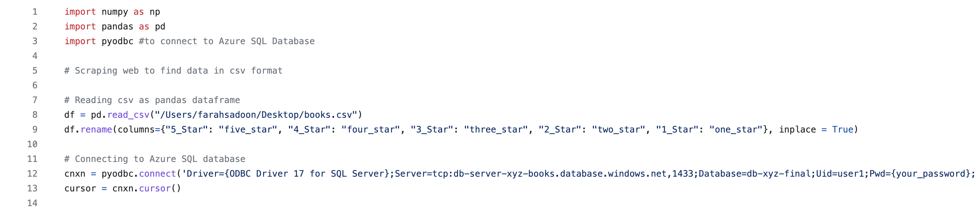
DATA ACQUISITION AND STORAGE
Reading CSV file from local computer into pandas dataframe, connecting to Azure SQL Database using a connection string.
We are reading CSV file from the local computer because the dataset was static and did not require an API to connect and update data.

Slide 5
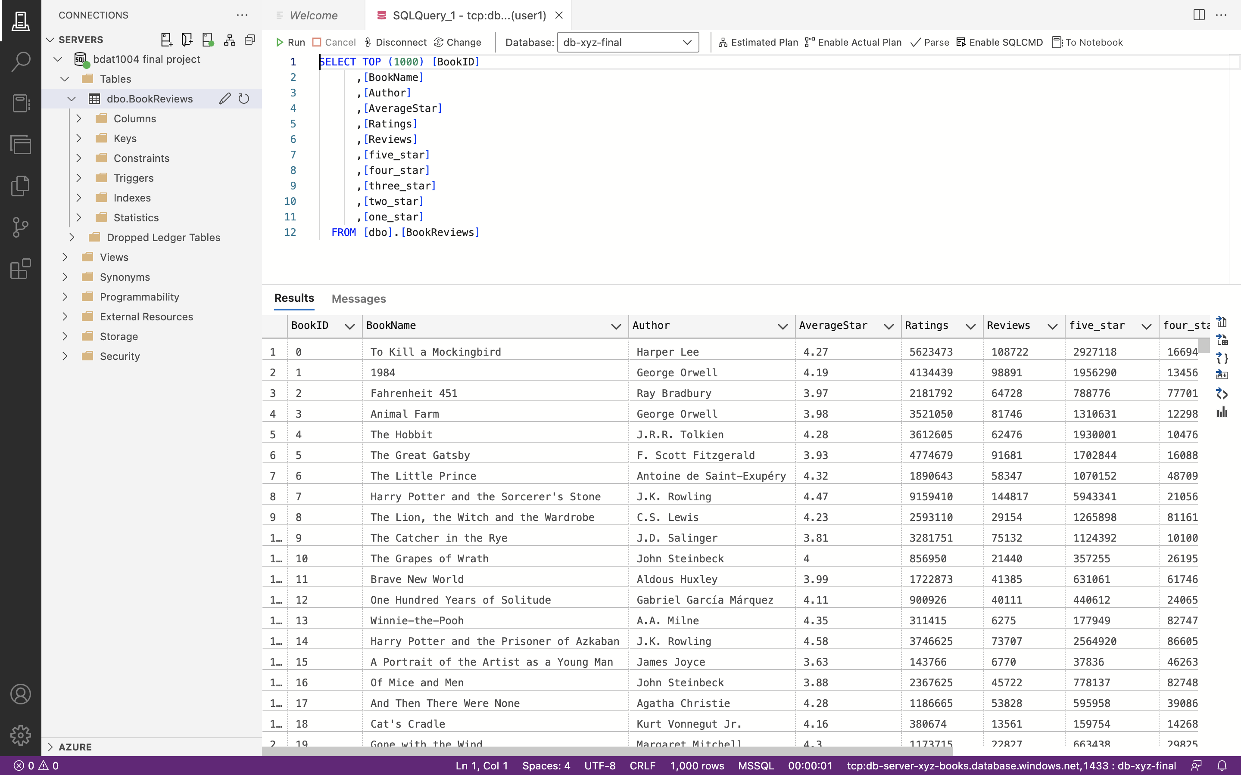
DATA ACQUISITION AND STORAGE (cont.)
Table "BookReviews" in SQL Database, showing a sample of the first 1000 rows of data loaded in from the previous slide's code:

Slide 6
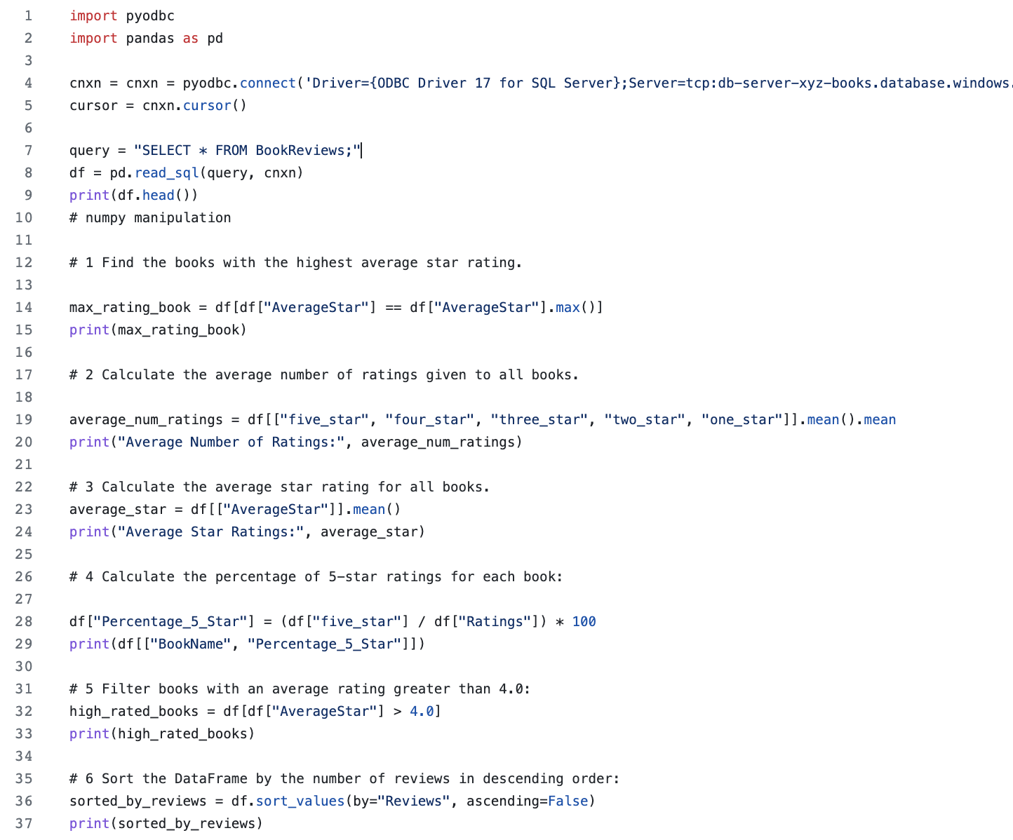
Data analysis
Connecting to the Azure SQL Database using a connection string and creating a pandas dataframe to compute certain calculations and aggregations.

Slide 7
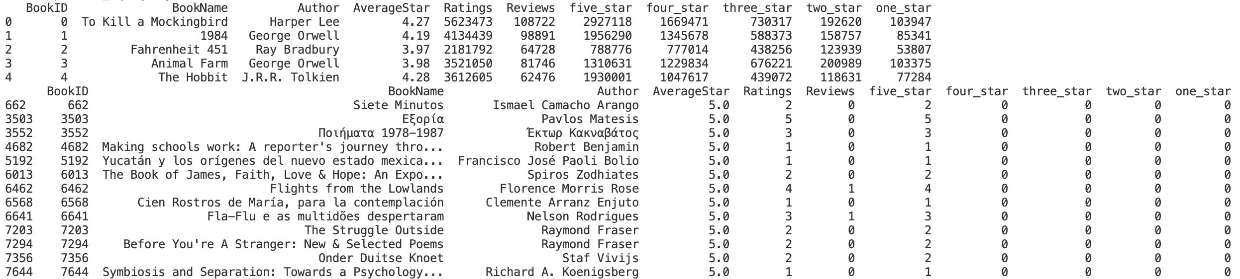
# 1 Find the books with the highest average star rating. max_rating_book = df[df["averagestar"] == df["averagestar"].max()] print(max_rating_book)

Slide 8
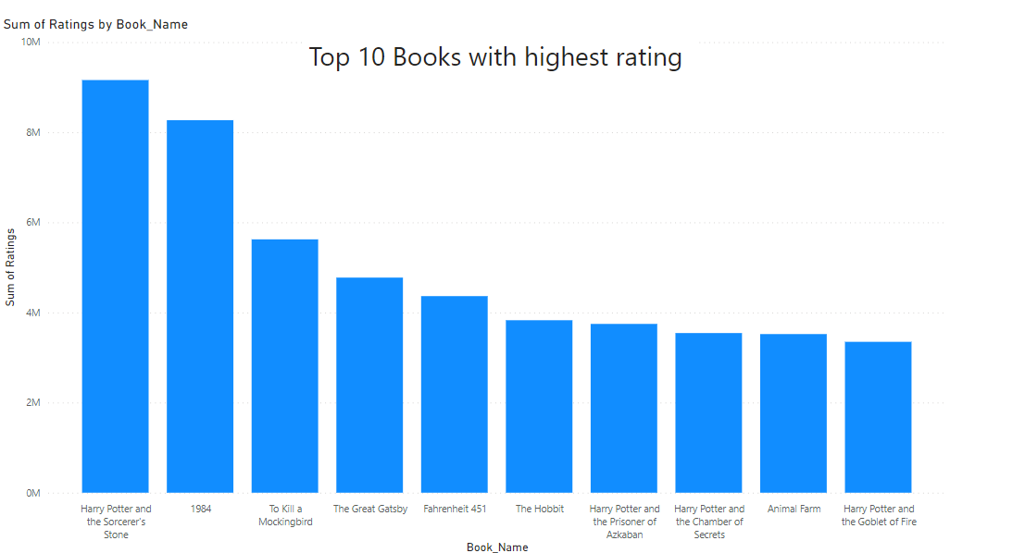

Slide 9
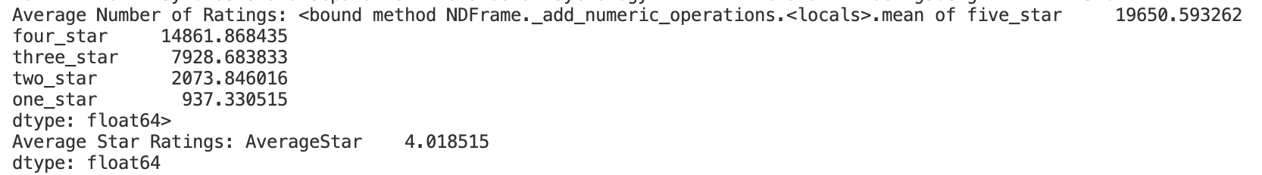
# 2 Calculate the average star rating for all books. average_star = df[["averagestar"]].mean() print("average star ratings:", average_star)

Slide 10
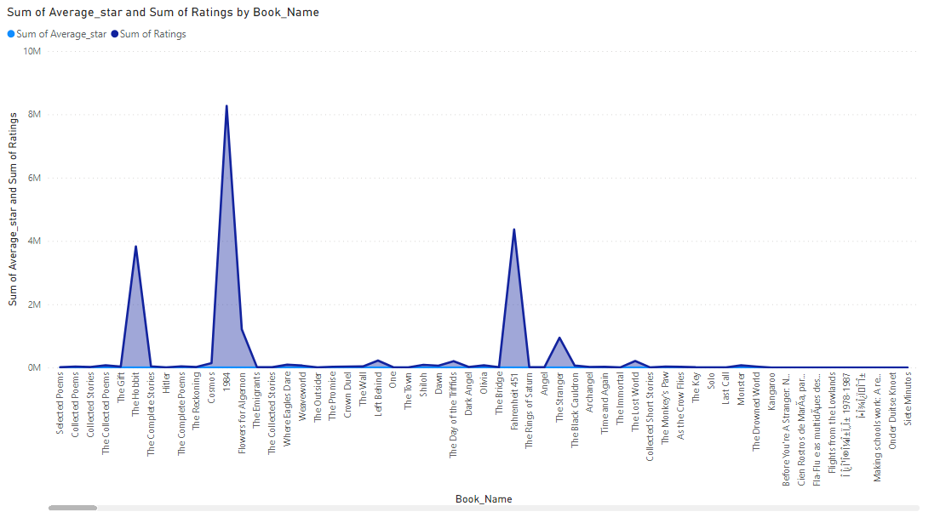
Average star rating for all books.

Slide 11
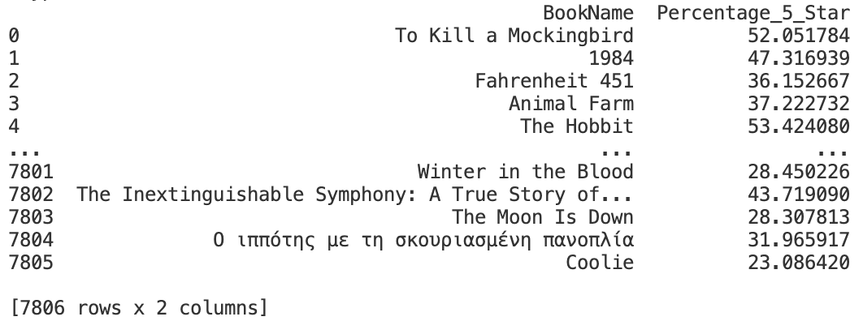
# 3 Calculate the percentage of 5-star ratings for each book: df["percentage_5_star"] = (df["five_star"] / df["ratings"]) * 100 print(df[["bookname", "percentage_5_star"]])

Slide 12
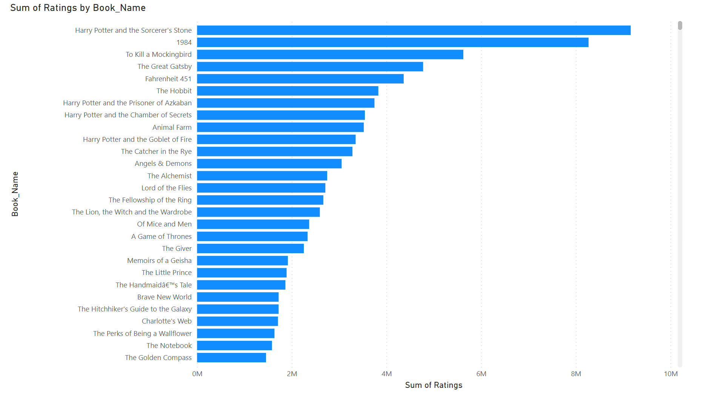
Percentage of 5-star ratings for each book

Slide 13
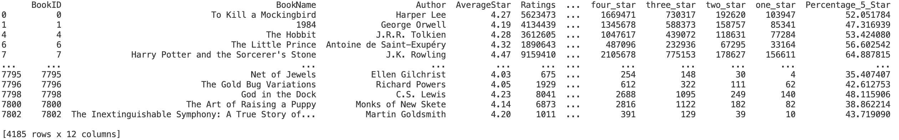
# 4 Filter books with an average rating greater than 4.0: high_rated_books = df[df["averagestar"] > 4.0] print(high_rated_books)

Slide 14
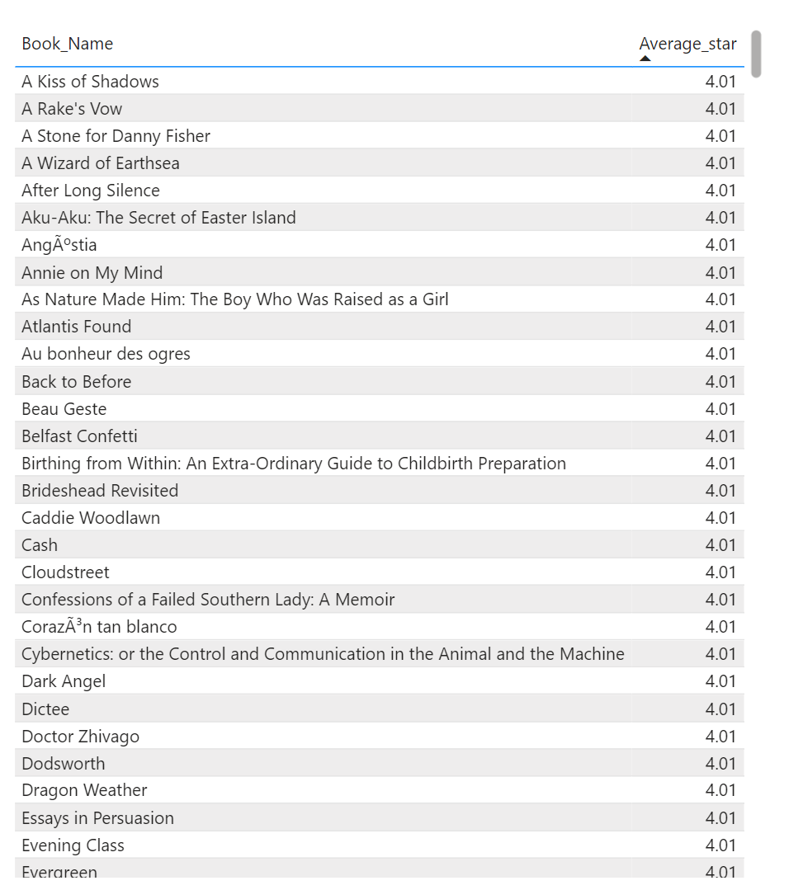
Books with Average star more than 4.0

Slide 15
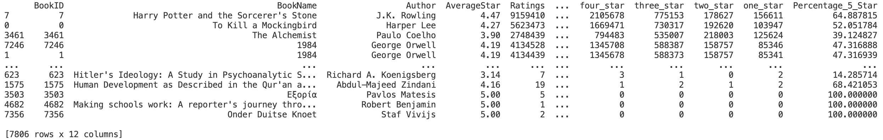
# 5 Sort the DataFrame by the number of reviews in descending order: sorted_by_reviews = df.sort_values(by="reviews", ascending=false) print(sorted_by_reviews)

Slide 16
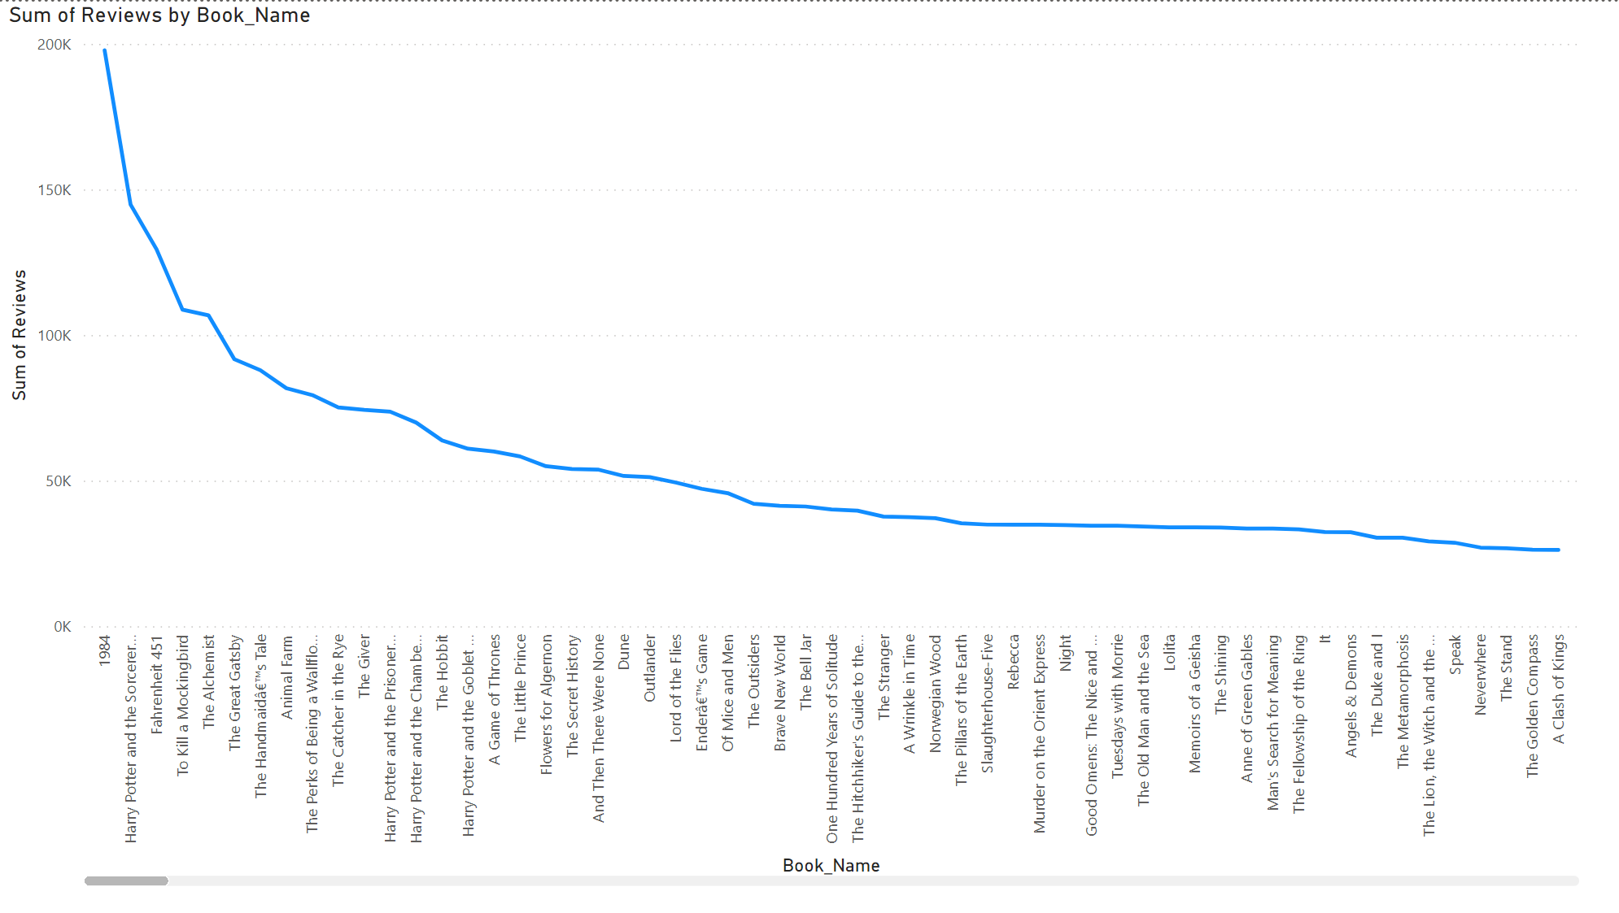
Descending order of book by the number of reviews.

